Slide 1
the odds (likelihood)
The odds are that he will commit the same crime again.
= It is likely that…/ Chances are that…
The odds are very much in our favour/against us.
Against all the odds, we managed to get through to the final.
These findings are at odds with what is going on in the rest of the country. 与……有分歧 conflict with
The architect favored small kitchens and closets—at odds with current tastes—and usually omitted basements.
一位顾问说这两个国家不会一直这样争执下去。
An adviser said there was no reason why the two countries should _______ ___ ______.
an odd-looking house
remain at odds
Notes:
我方胜算几率很大。
against all odds 克服一切困难，尽管困难重重
odd numbers 奇数 even numbers 偶数
at odds with sth （conflict）有差异，相矛盾
sb 有分歧
建筑师偏爱小厨房和壁橱——与当前的品味不一致——并且通常省略地下室。

Slide 2
apply
_____ _____ the company _____ a job
They can better ______ theory ______ practice.
He has applied himself to this task with considerable energy.
该规定对于在公司里拥有股份的人适用。
The rule applies ______ a person owns stock in a corporation.
The rule _______ ______ the person who owns…
What is a reasonable standard for one family is not __________ to another. 对一个家庭合理的标准对于另一个家庭并不适用。
the __________ of new technology to teaching
an _______ _______ a job
apply to for
apply to
where
applies to
applicable
application
applicant for
Notes:
他已经花了相当多的精力致力于这项任务。(勤奋工作，努力学习)

Slide 3
prior knowledge
Although not essential, some ______ ____________ (之前的知识) of statistics is desirable.
She will be unable to attend because of a prior engagement.
Book your tickets at least two weeks ______ __ your _________.在你离开前
They have a prior claim to the property.
他们有权优先获得该处房产。
(priority, prioritize)
将要做的事情列出来，然后决定其优先顺序。
Make lists of what to do and prioritize your tasks.
sth is my _____ _______. 头等大事
优先考虑某事
prior to departure
first priority
give priority to sth
Notes:
因事先有别的安排，她将不能出席。
忙着其他事情。

Slide 4
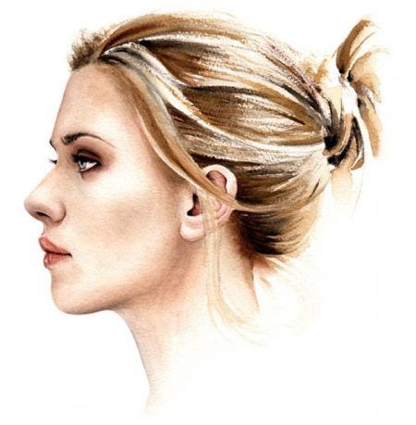
a picture of a person in profile
侧画像
You can update your Facebook profile.
(= your description of yourself on a social networking website).
This issue has had a high profile in recent months.
惹人关注 attention from the public
I advised her to keep a low profile for the next few days.
The data will enable us to construct/build up a detailed profile of the firm’s clients.
a campaign to raise the profile of the city as a cultural leader
The rise and fall of the British Empire _____ _____ in this month’s journal.
is profiled
Notes:
他的侧影 his profile
(= your description of yourself on a social networking website).
the outline of a person's face when you look from the side, not the front
She decided to keep a low profile until the scandal had died down.
建立起公司客户的详细资料。
提升公司形象
本月期刊概述了大英帝国的兴衰。
psychological profiling

Slide 5
Reading through your notes before the exam can refresh your memory.
The page refreshes automatically.
The long sleep had refreshed her.
She _______ ________ after a long sleep. 感到爽快
a _________ drink 提神饮品
It's refreshing to hear somebody speaking common sense.
听到有人说话通情达理真是令人耳目一新。
It made a refreshing change to be taken seriously for once.
refreshingly different 焕然一新
light refreshments (n. (公共)饮料，小食)
felt refreshed
refreshing
Notes:
帮你回忆学过的知识。/提醒自己
一场酣睡使她重又精力充沛。
总算有一次受到认真对待，这变化真是令人耳目一新。

Slide 6
Commuters face long delays on the roads every day.
Report it to the police _______ _______. 赶快
I ________ _________ it to the police. 我没有马上把消息告诉警方。
postpone / put off
Commuters were delayed for two hours today.
被耽搁 hold up
without delay
delayed reporting
Notes:
远距离通勤者每天都要在路上耽误很多时间。

Slide 7
durable plastics
durability
rudely
rudeness
justify (sth): prove to be right
How can they justify paying such huge salaries?
defend 对……作出解释，为……辩解
You don’t need to justify yourself to me.
I can see no possible _____________for any further tax increases.我看不出还能提出什么理由再加税。
These experiments are _______ __________. 合乎道德标准 (adv. + adj.)
justification
morally justifiable
Notes:
durability of gold
他们怎能证明付这么大笔薪金是正当的呢？
你不必向我解释你的理由。defend
我们怎么才能解释花那么多钱购买武器是正当的呢？
合乎道德准则。

Slide 8
These comments are not ______ ______ this enquiry.
be irrelevant to…
be related to
be linked to/with
be connected with
be concerned with / concerning
be associated with
as regards / regarding
involving
relevance
relevant to
Notes:
这些意见与这项调查没有联系。

Slide 9
be inferred from
Much of the meaning must ________________ the context.
Are you inferring (that) I'm not capable of doing the job?
What __________ have you ______ ______ this evidence?
从……中推论出结果
If he is guilty, by inference, so is his wife.
由此推论
inferences drawn from
Notes:
你的言外之意是不是我不能胜任这份工作？

Slide 10
was about to when
The little boy ___ ___ ___ run across the road, ____ his mother _________________________________.正要……时抓住了他的胳膊
The police seized three men for possession of illegal drugs.
He seized the gun from the bank robber.
Our enemy seized the control of the city, but soon our army seized power of the city again.
seize every possible opportunity to practice my English
把握主动 seize the initiative
seize the moment
她惊慌失措。Panic ______ ____.
be seized by fear/pain/a sudden desire to do …
seized him by the arm/seized his arm
seized her
Notes:
扣押
把……从某人那里夺过来
夺取控制权，夺取政权

